Slide 1
Internet of things

Slide 2
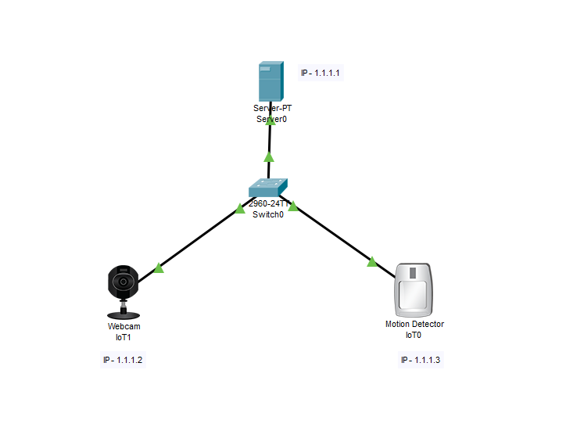
Iot in packet tracer

Slide 3
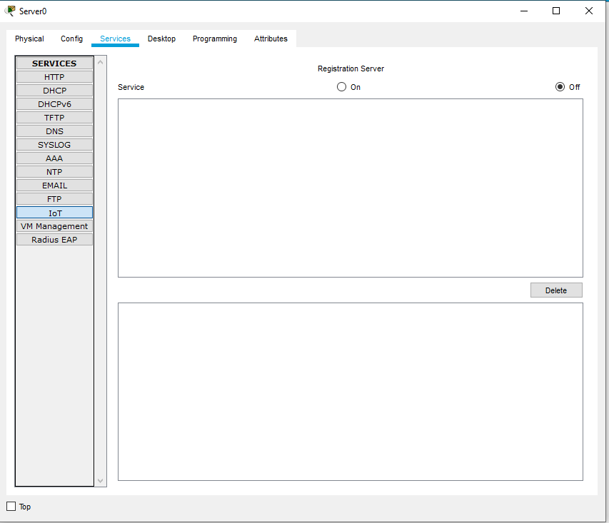
Server as iot device

Slide 4
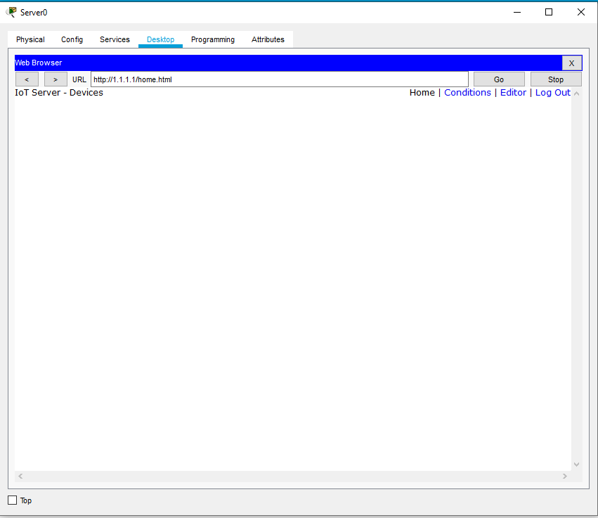
Setting up configuration

Slide 5
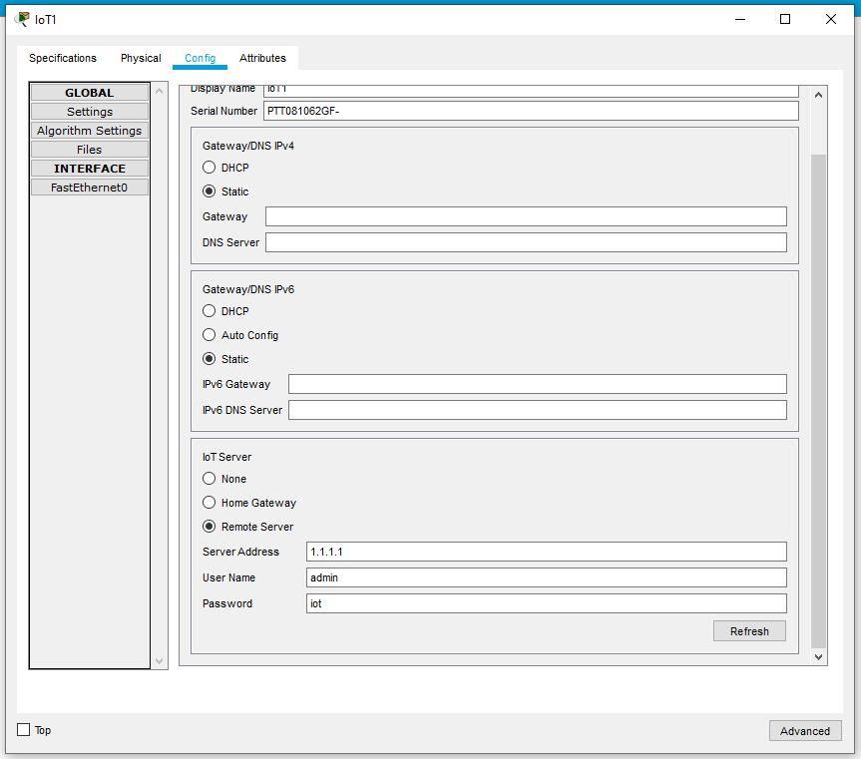
Configuring web-cam

Slide 6
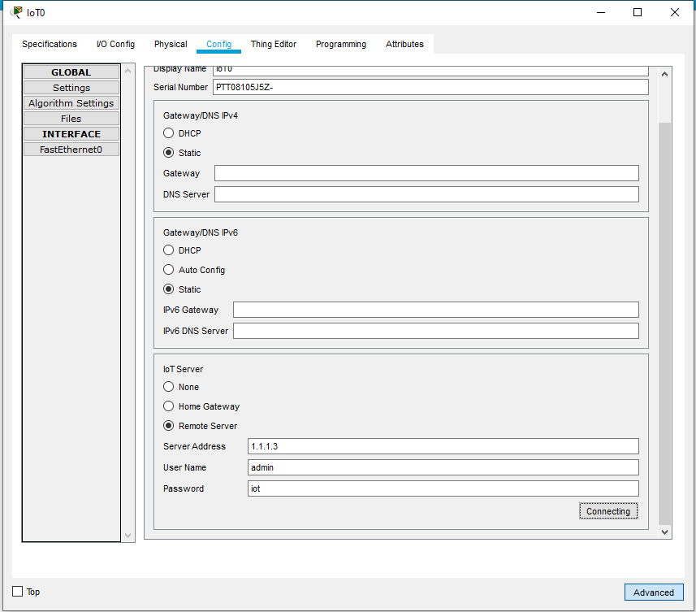
Configuring web-cam

Slide 7
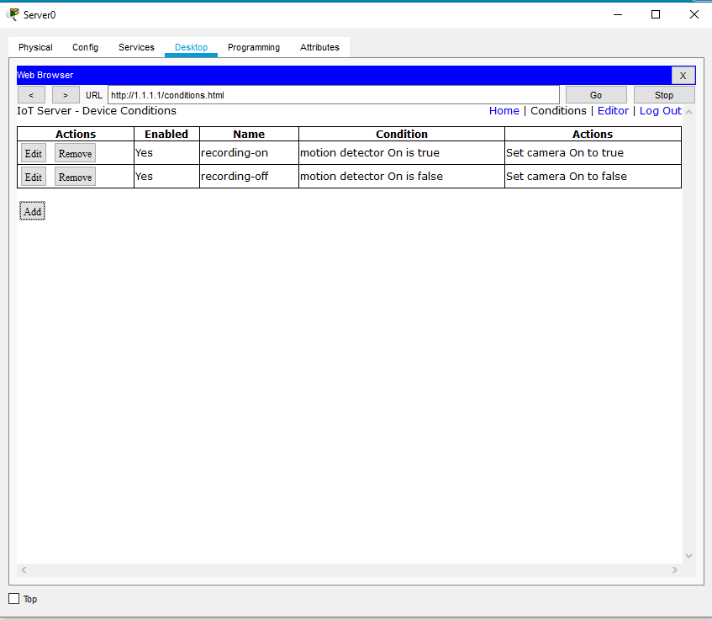
programming

Slide 8
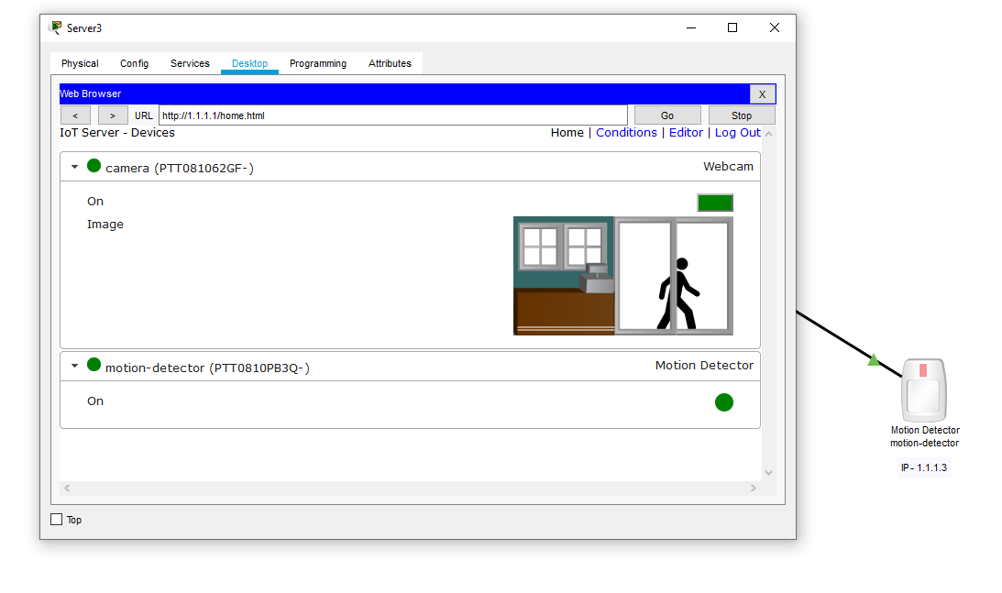
Motion detection

